Slide 1
Section 5

Slide 2
Admin
Office Hours: Wednesday 1-2PM!
Done with Homework 1!
Homework 2: Tuesday, February 16, 2021
Get started early!
Course and Section Feedback?

Slide 3
Agenda
Gradient Descent (~10 min)
Subgradients (~15 min)
Question 3
Convexity (~25 min)
Questions 1,2

Slide 4
Gradient Descent

Slide 5
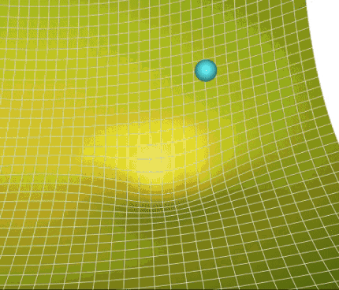
Gradient Descent – Algorithm
A Visual Explanation of Gradient Descent Methods (Momentum, AdaGrad, RMSProp, Adam) | by Lili Jiang | Towards Data Science

Slide 6
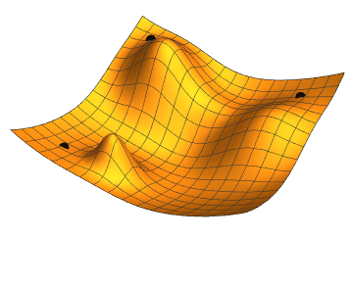
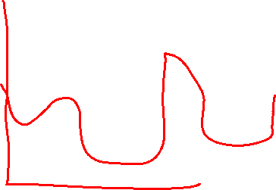
Gradient Descent – Starting Points
File:Gradient descent.gif - Wikimedia Commons

Slide 7
Subgradients

Slide 8
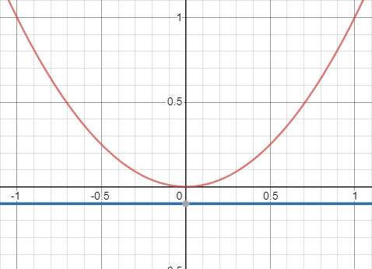

Subgradients – 1D
This is a subderivative!
What if$f\left(x\right)$ is non-differentiable at $x_{0}$?

Slide 9



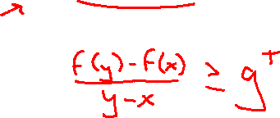

Subgradients – Many Dimensions
What if$f\left(x\right)$ is non-differentiable at $x$?

Slide 10
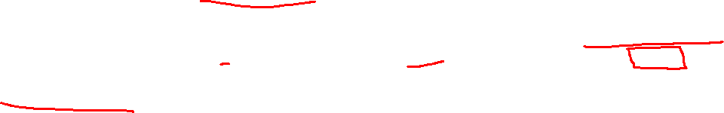
Subgradients – Many Dimensions
What if$f\left(x\right)$ is non-differentiable at $y$?

Slide 11
Subgradients – (3a)

Slide 12
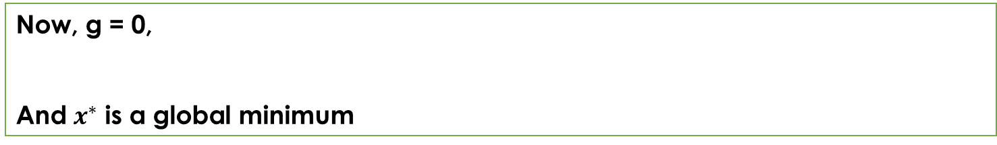
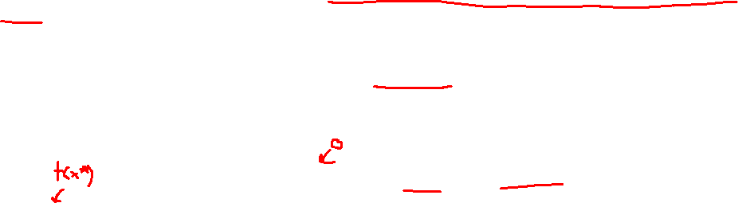
Subgradients – (3a)
Gradients are important for many tasks (i.e. Gradient Descent). Suppose the analytical solution for our gradient was complex we could take the subgradient! For example, subgradient descent.
Now, g = 0,
And $x^{∗}$ is a global minimum

Slide 13
Subgradients – (3b)

Slide 14
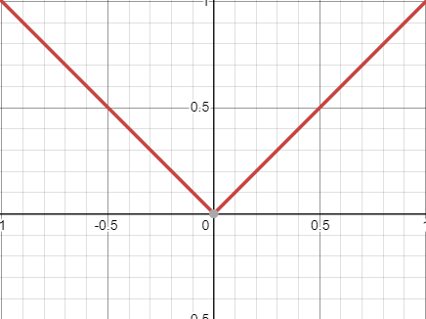

Subgradients – (3b)

Slide 15
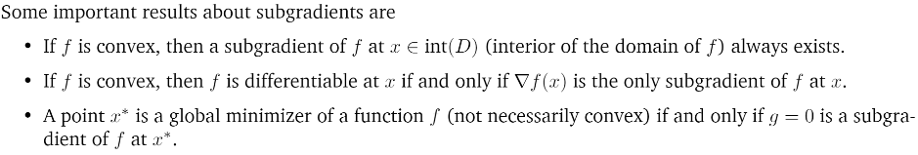

Subgradients

Slide 16
Convexity

Slide 17
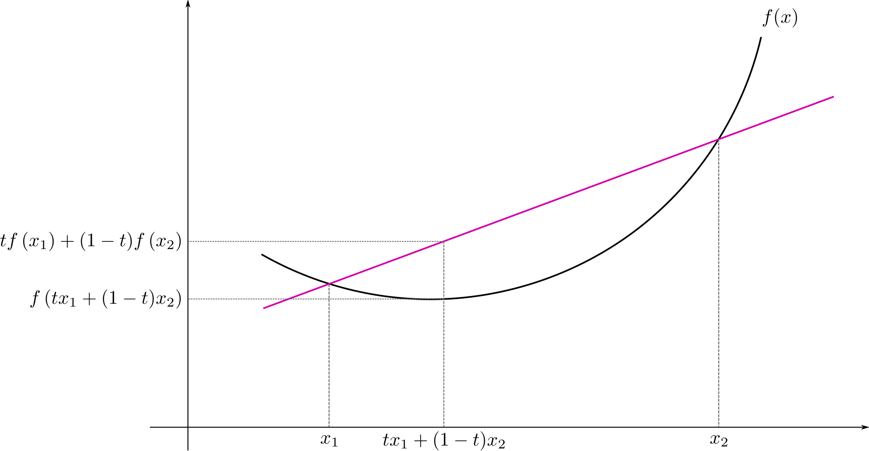
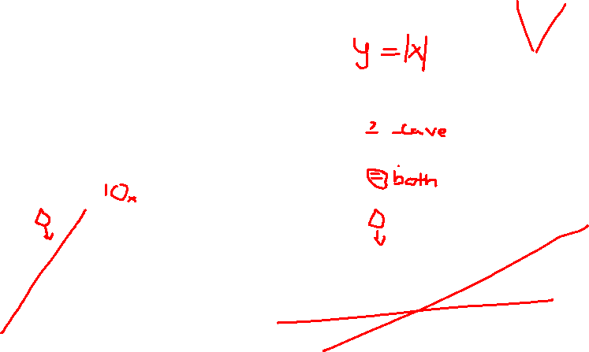
Convexity
Can your function hold water?

Slide 18
Convexity – (1a)

Slide 19
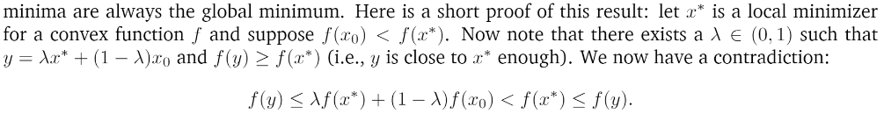
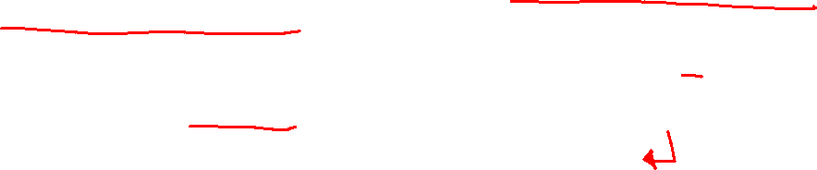
Convexity – (1a)
Optimization depends on finding local minima. With convex functions local minima are global minima.

Slide 20


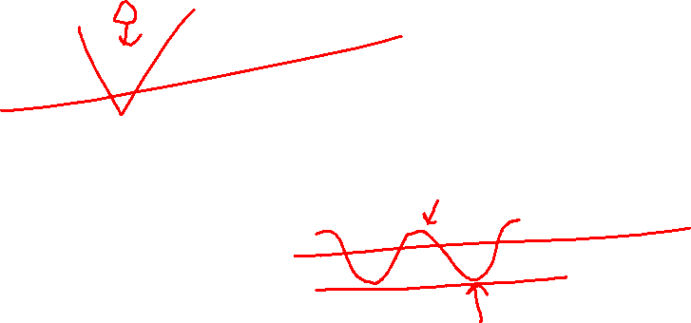
Convexity – (1b)

Slide 21

Convexity – (1b)
Proof via triangle inequality:
Draw a line!
Check algebra at home (a little complex)

Slide 22
Convexity – (1c)

Slide 23
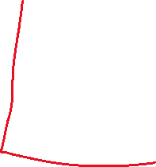

Convexity – (1c)
For linear functions we have:

Slide 24
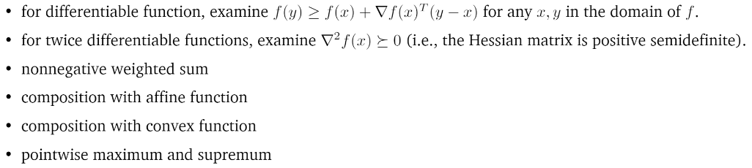
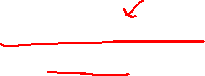
Checking Convexity
Lots of strategies that don’t rely on the definition!

Slide 25
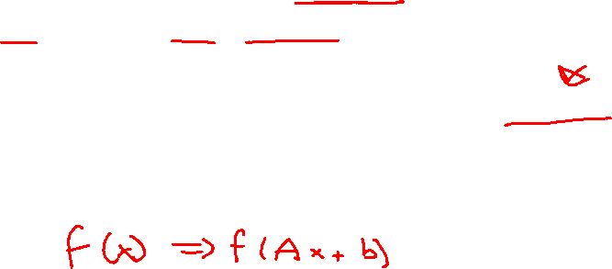
Checking Convexity – (2g)
Strategies:

Slide 26





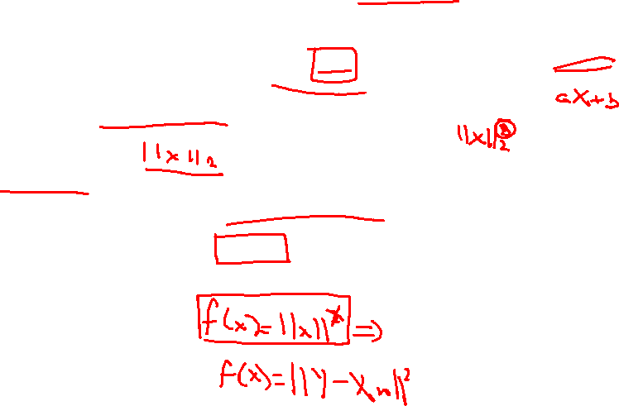
Checking Convexity – (2g)
Proof via triangle inequality:
Note that we only need to show since is an affine transformation of w.
Hessian:
is PSD

Slide 27
Checking Convexity – (2d)
Strategies:

Slide 28
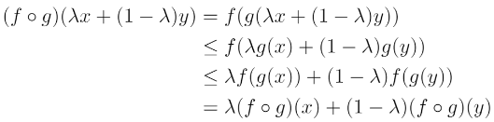

Checking Convexity – (2d)
Proof via triangle inequality

